Slide 1
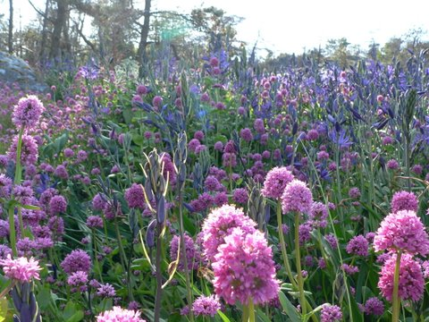


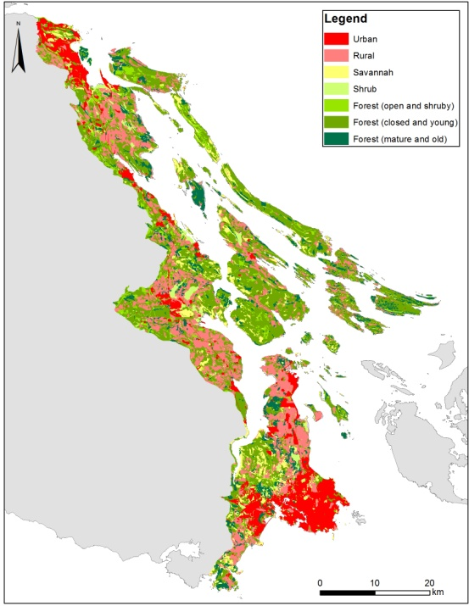
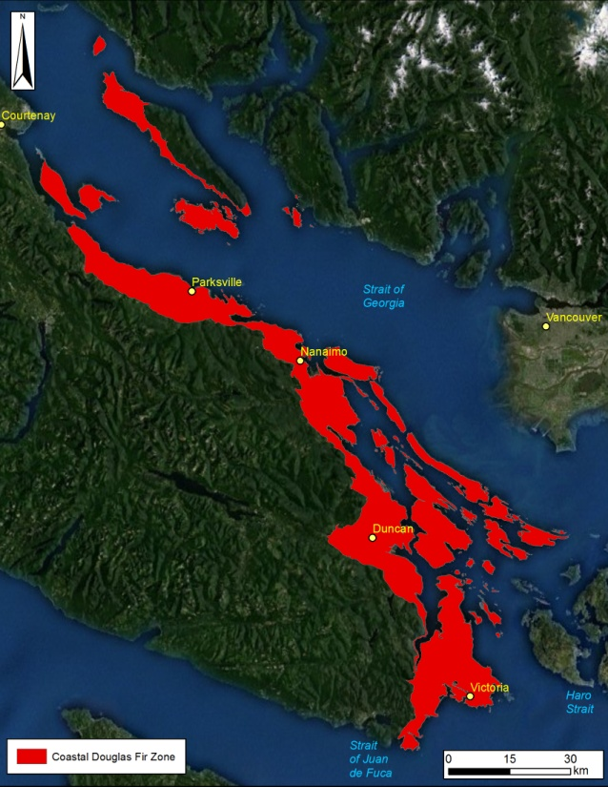
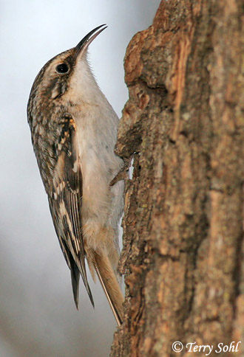
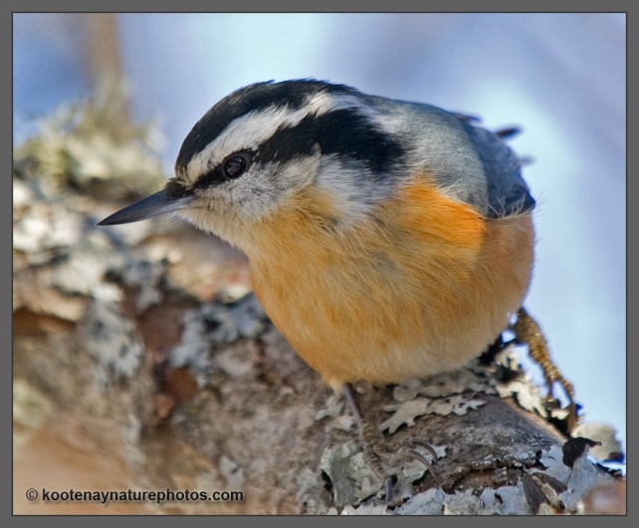
Introduction to conservation prioritization tools
Richard Schuster
Liber Ero Fellow, Carleton University
Adjunct Prof, Ecosystem Science and Management Program, UNBC

Slide 2
How can we combine all this information in a meaningful way for conservation?
Decision support tools: Marxan
Planning units (e.g. properties, watersheds, hexagons, …)
Species or Feature targets (e.g. protect 20% old forest, …)
Create compact reserve systems to reduce e.g. edge effects

Slide 3
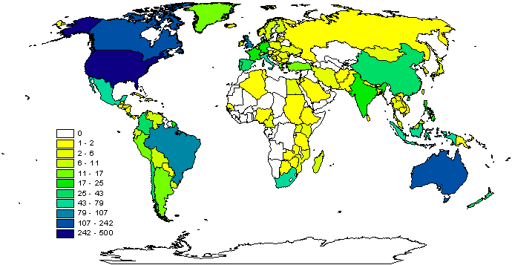
Why Marxan?
Aids systematic conservation planning
Near optimal spatial reserve systems
Most widely used worldwide
Transparent, inclusive and defensible decision making process
2009

Slide 4
What can Marxan do?
Identify areas that meet targets for a range of input features for minimal cost
Uses concept of complementarity (Select new conservation areas so that each one complements the others in the biodiversity features they contain)
Can maximise compactness
Can include data on ecological processes, threats, and condition
Decision-support, not a decision-maker

Slide 5
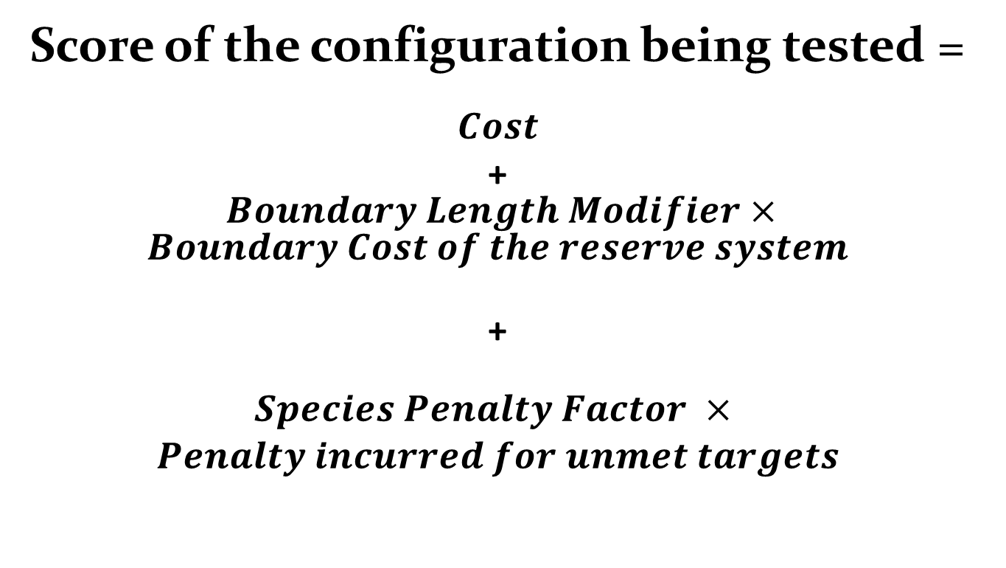
What problem does Marxan solve?
Score of the configuration being tested =
$$Cost$$
+ $Boundary Length Modifier×Boundary Cost of the reserve system$
+
$$\begin{aligned}Species Penalty Factor × \\ Penalty incurred for unmet targets\end{aligned}$$

Slide 6
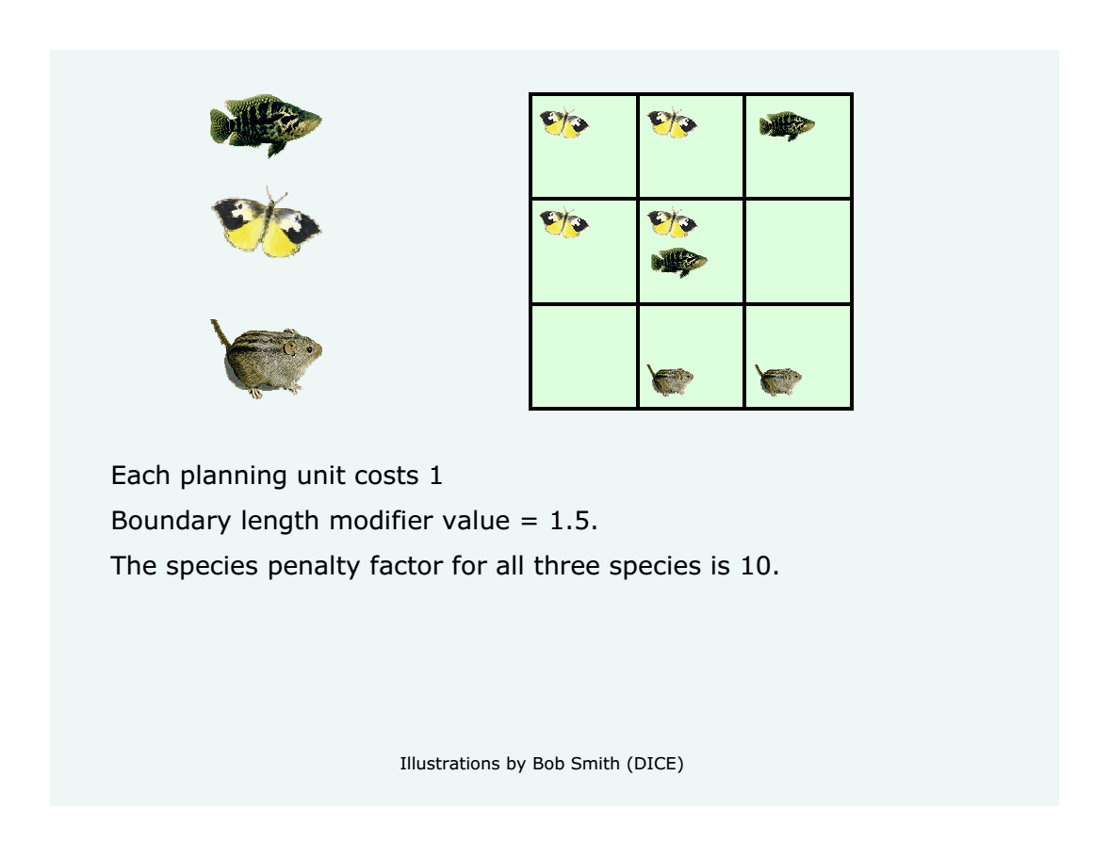

Slide 7
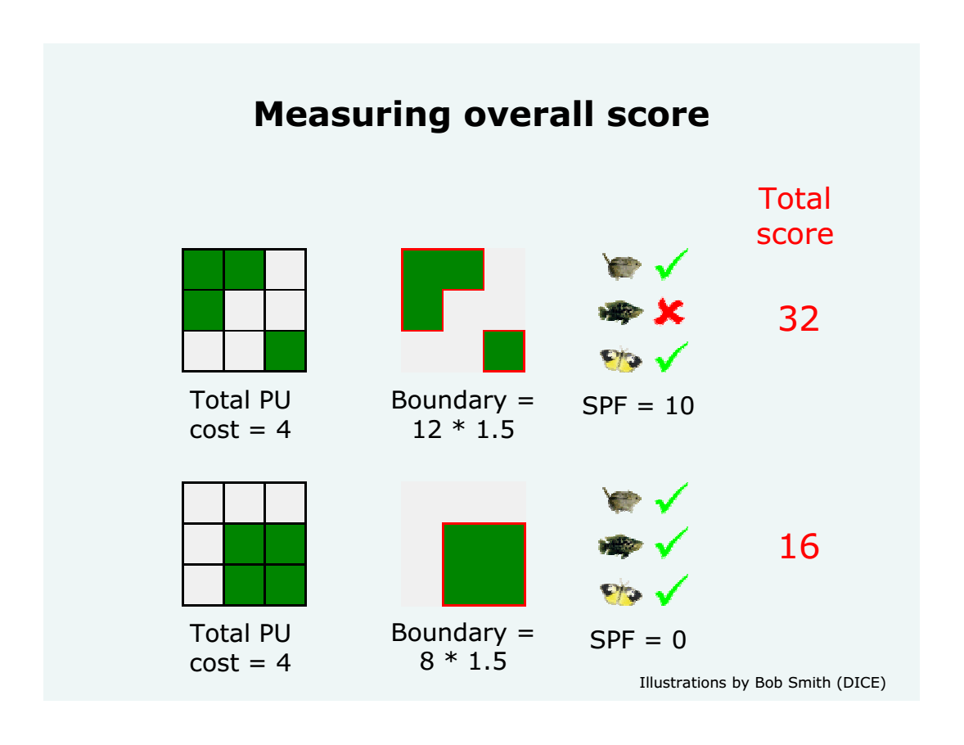
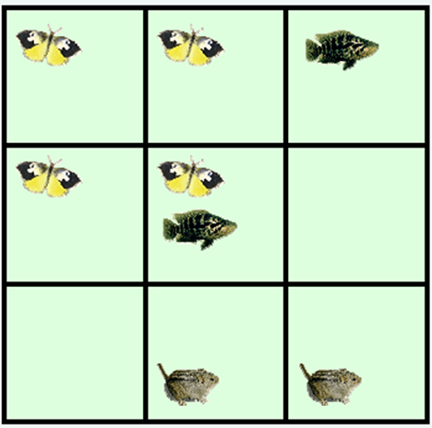

Slide 8
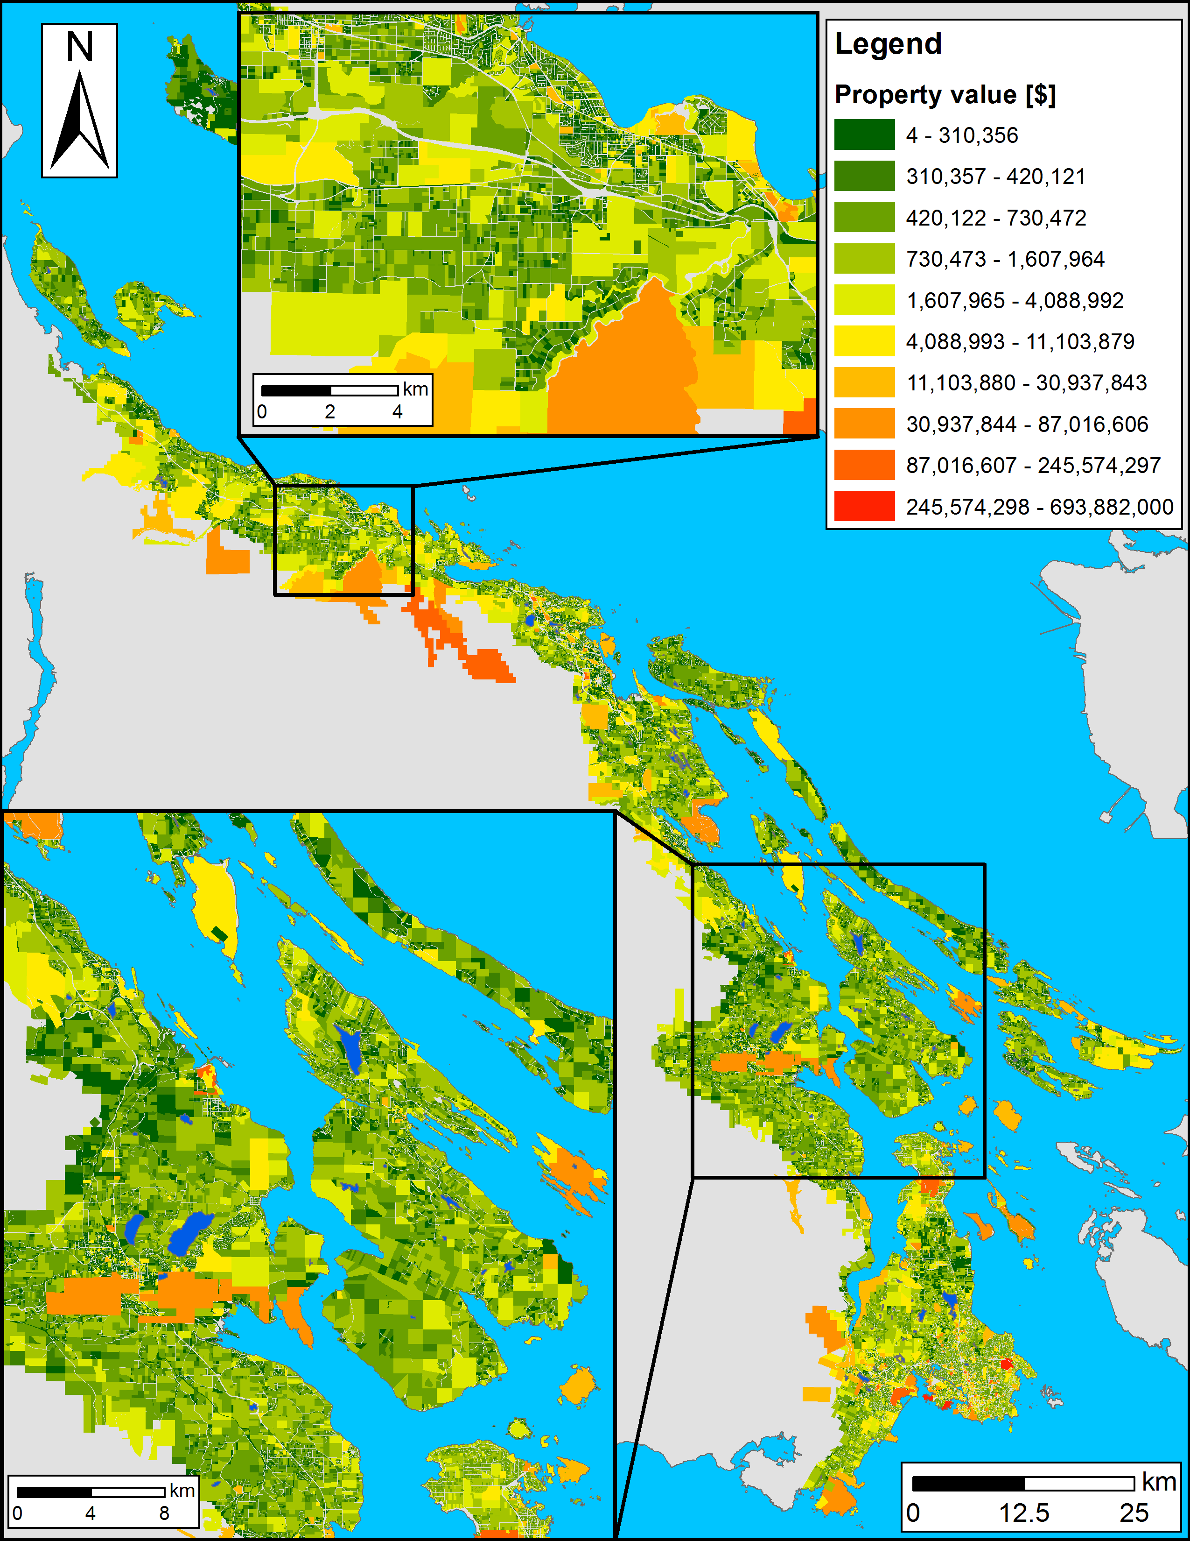
Planning units
Land base of the CDFCP: ~198,000 properties
Possible solutions for a reserve system: 2^198,000 > atoms in the Universe
How to optimize prioritization? Simulated Annealing

Slide 9
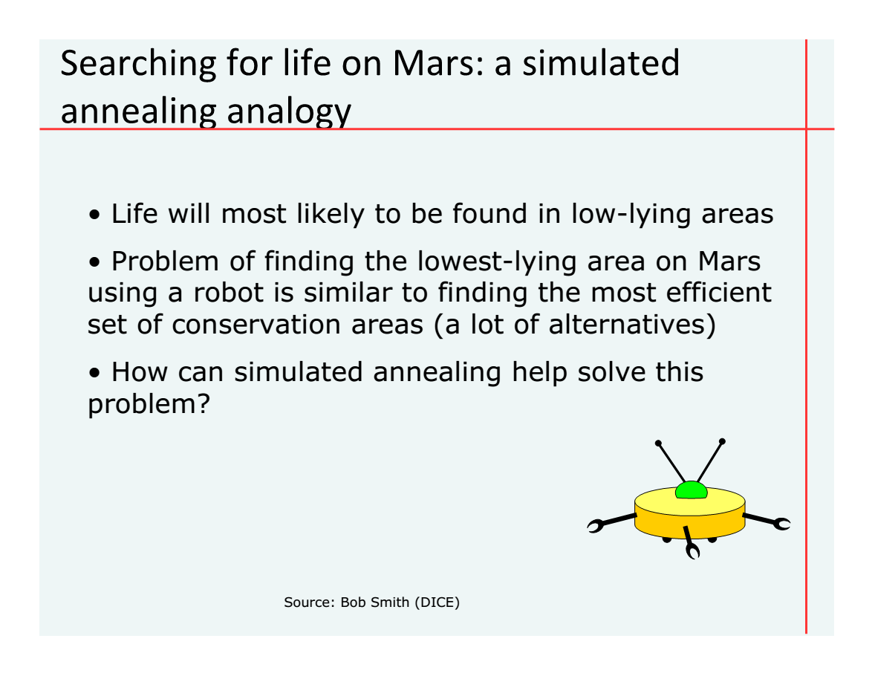

Slide 10
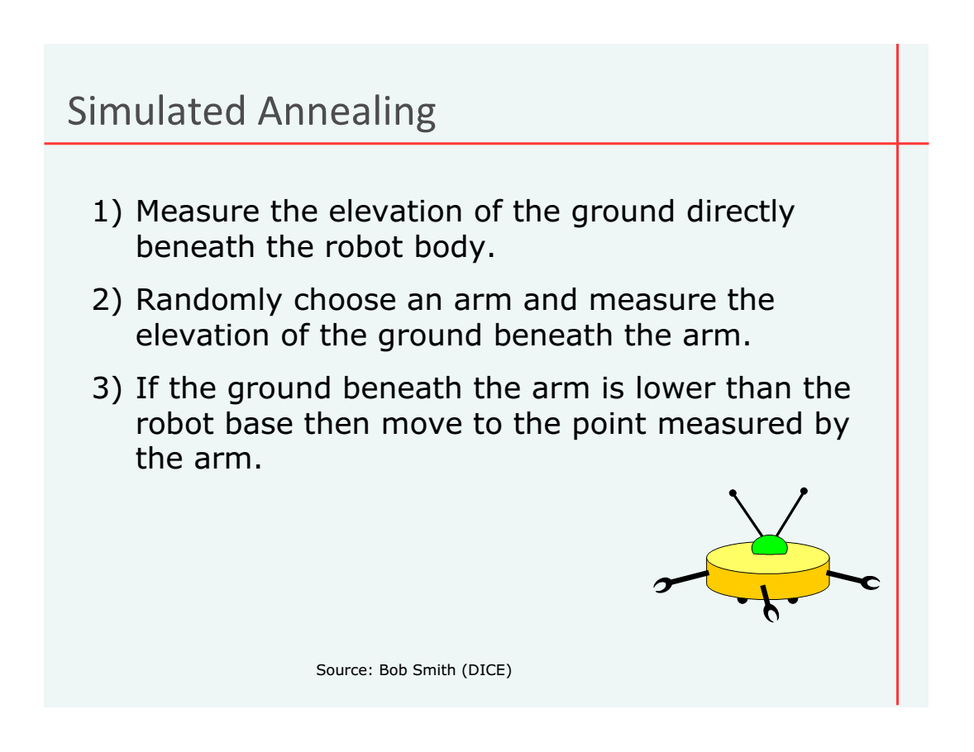

Slide 11
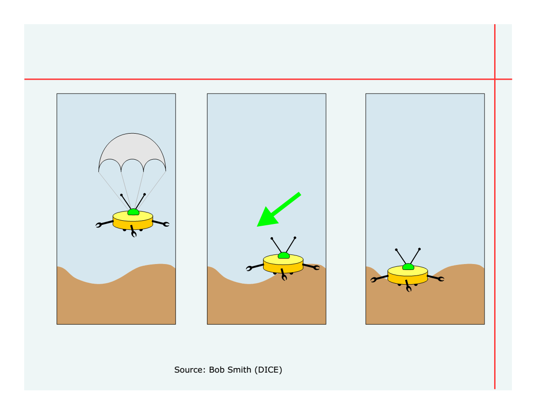

Slide 12
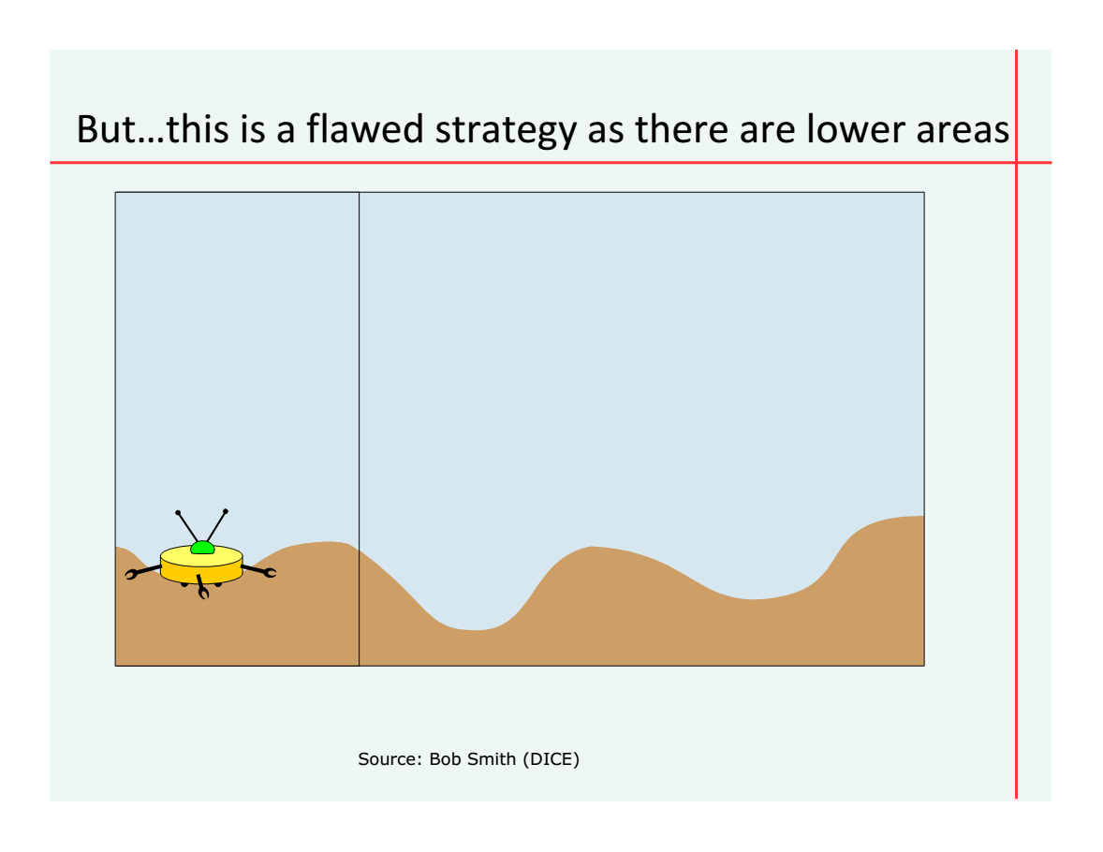

Slide 13
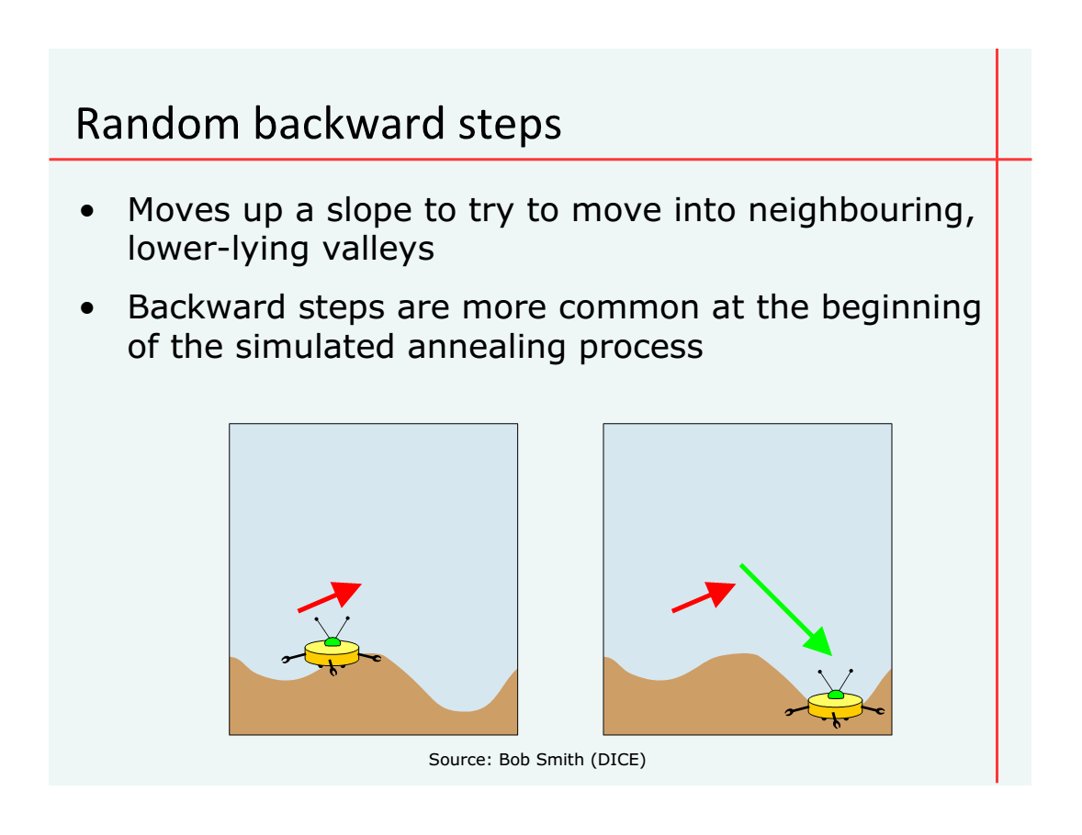

Slide 14
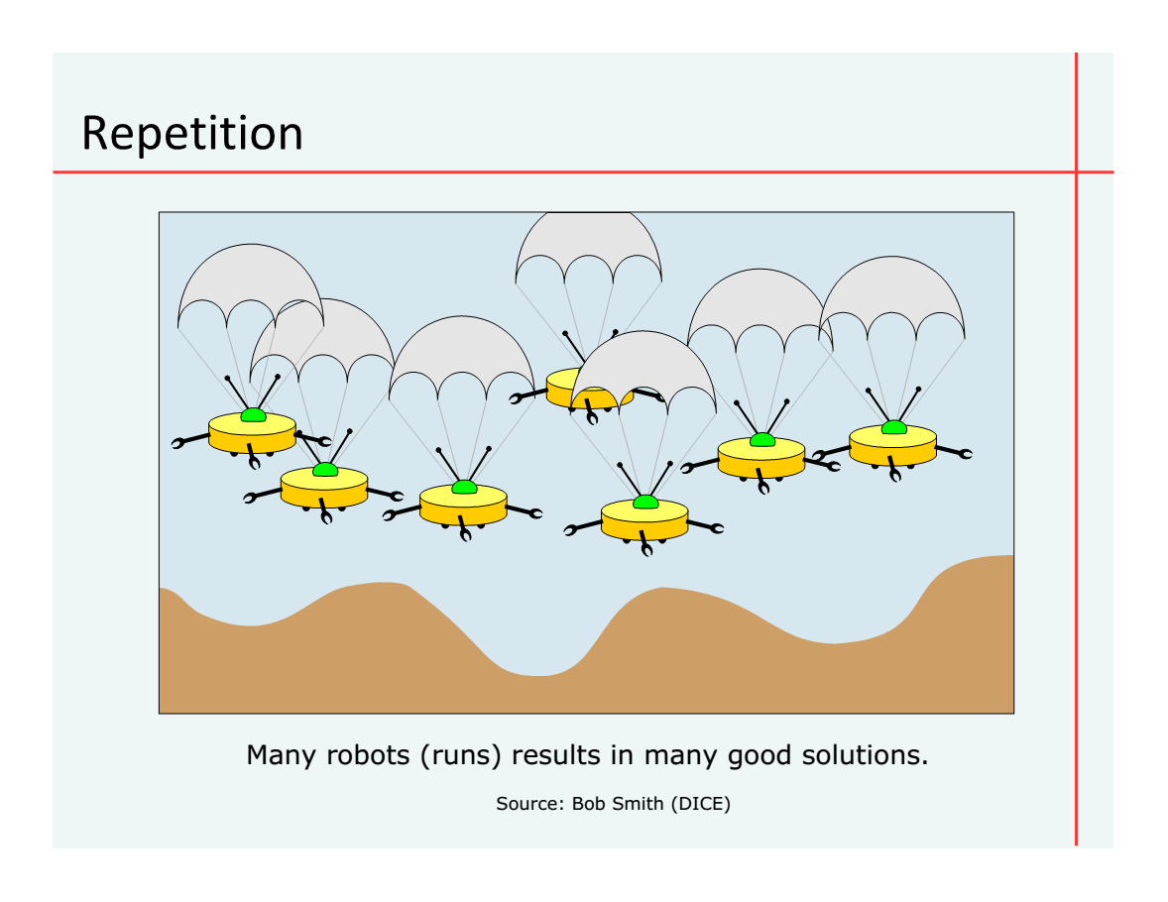

Slide 15










Coastal Douglas Fir Conservation Partnership: Facilitate Consensus Decisions on Protection

Slide 16

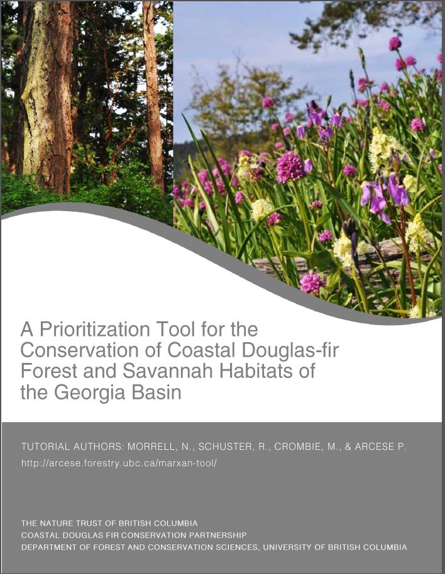
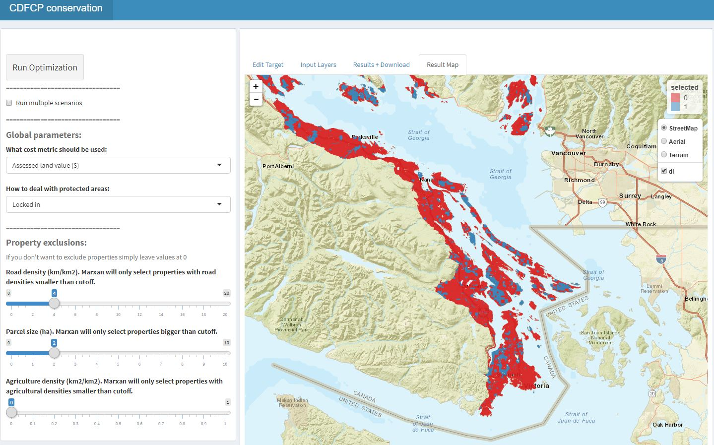
Current tool version
http://forbasin.forestry.ubc.ca/CDFCP_prioritization/

Slide 17
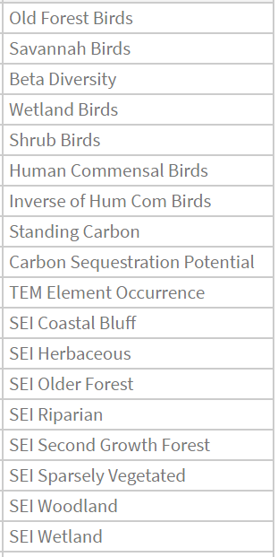
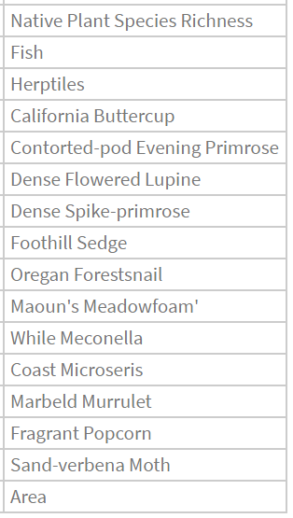

Slide 18
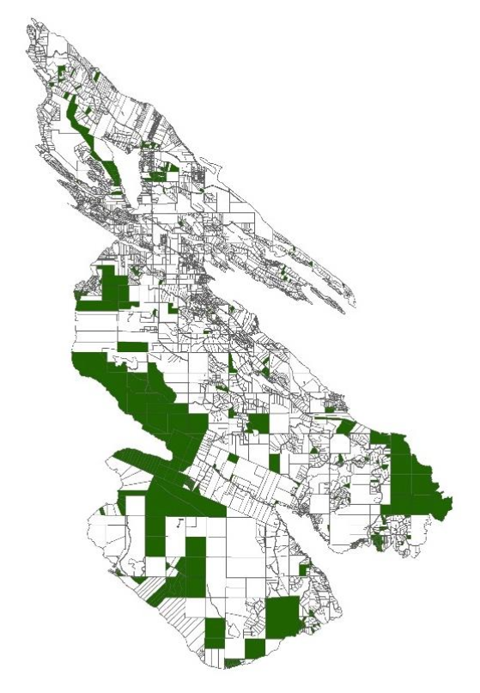
Applications?
Acquire Biodiverse Parcels
Minimize Management Costs, Maximize Return on Conservation Investments
Develop Contact Lists to Engage Private Landowners in Conservation at Landscape Scales

Slide 19
Current work: Optimizing conservation of migratory species over their full annual cycle in the Western Hemisphere
Relative abundance models from eBird
109 Neotropical migrant bird species
Full annual cycle

Slide 20
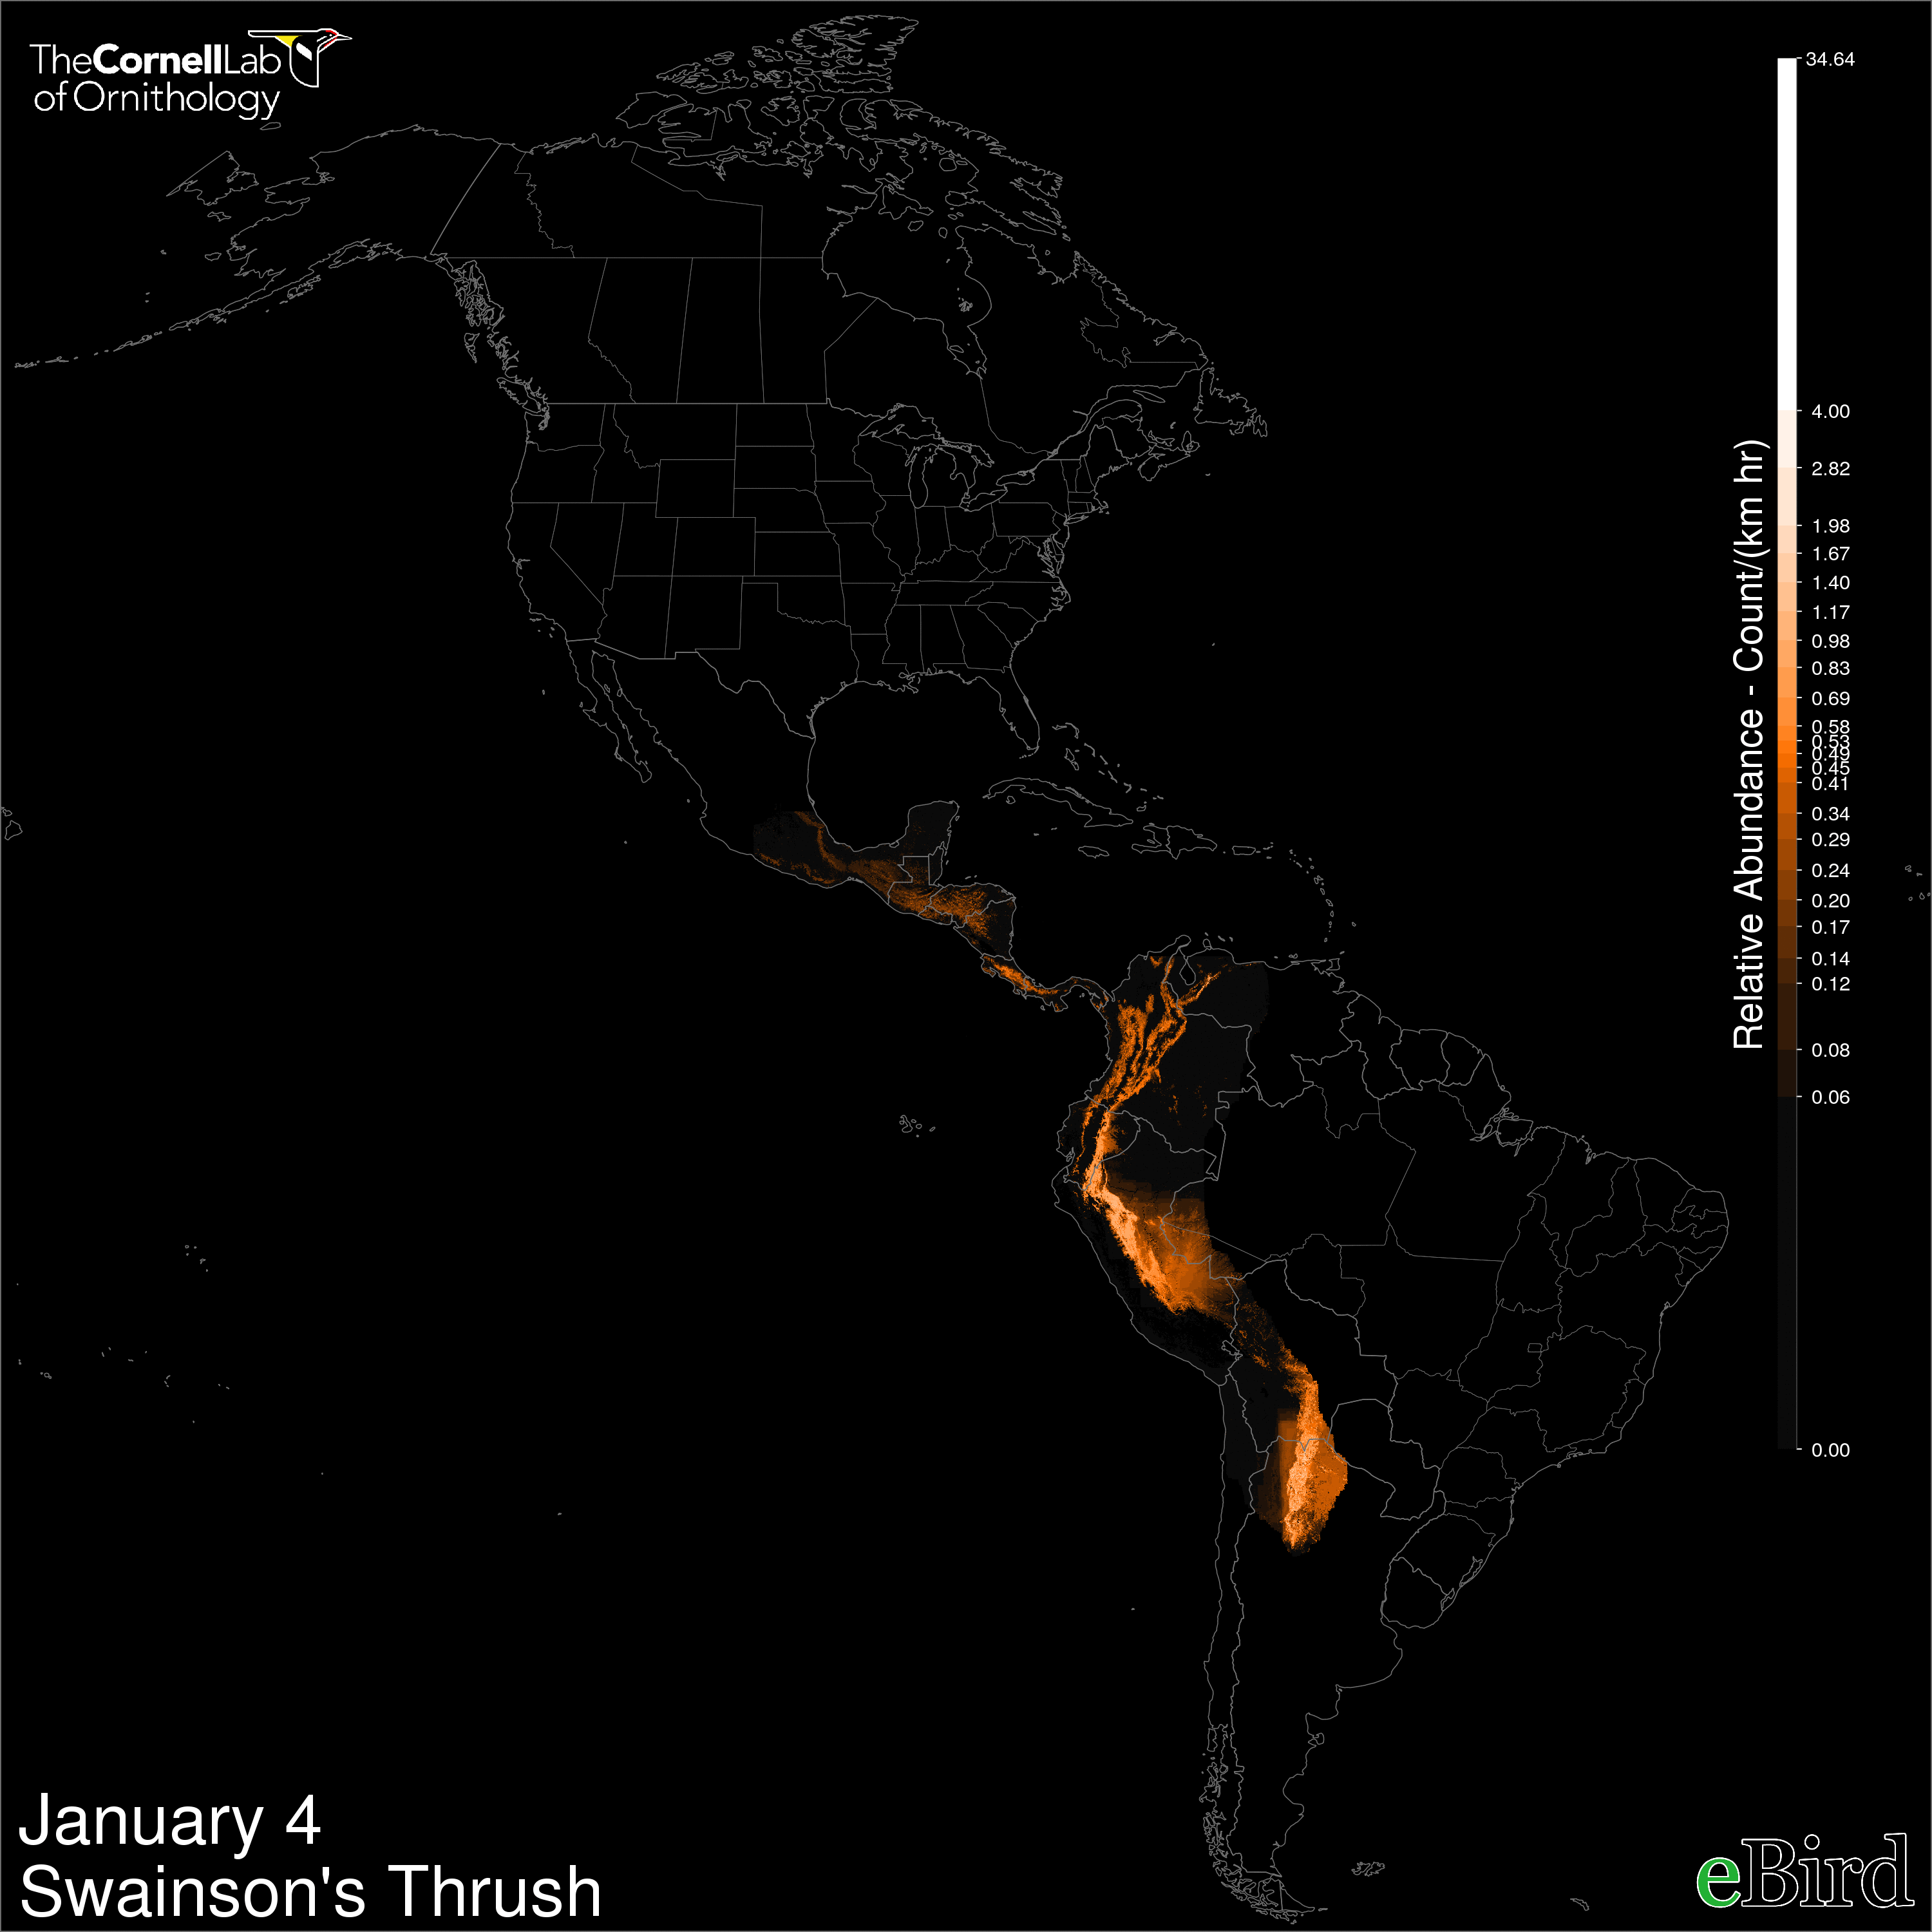



Slide 21
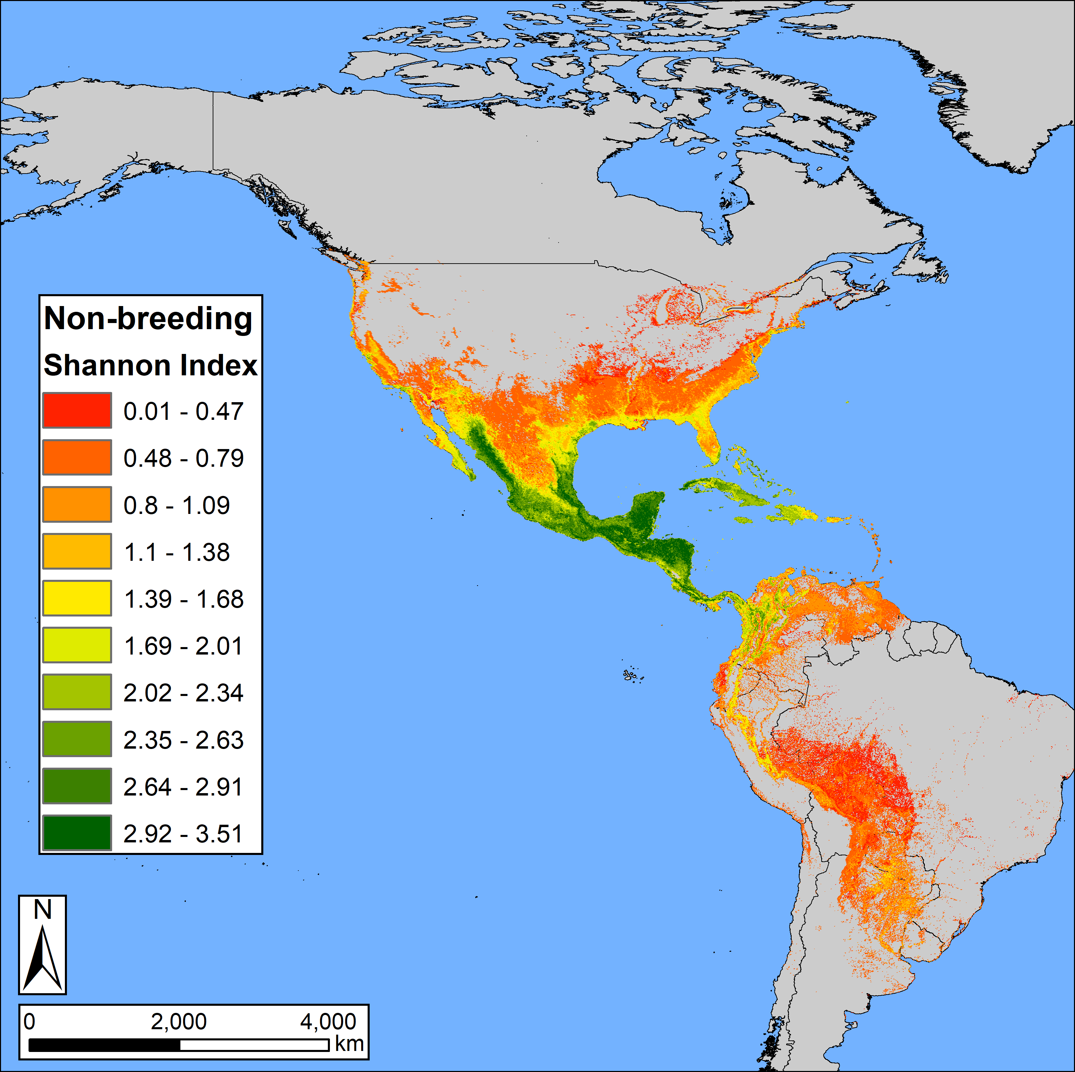
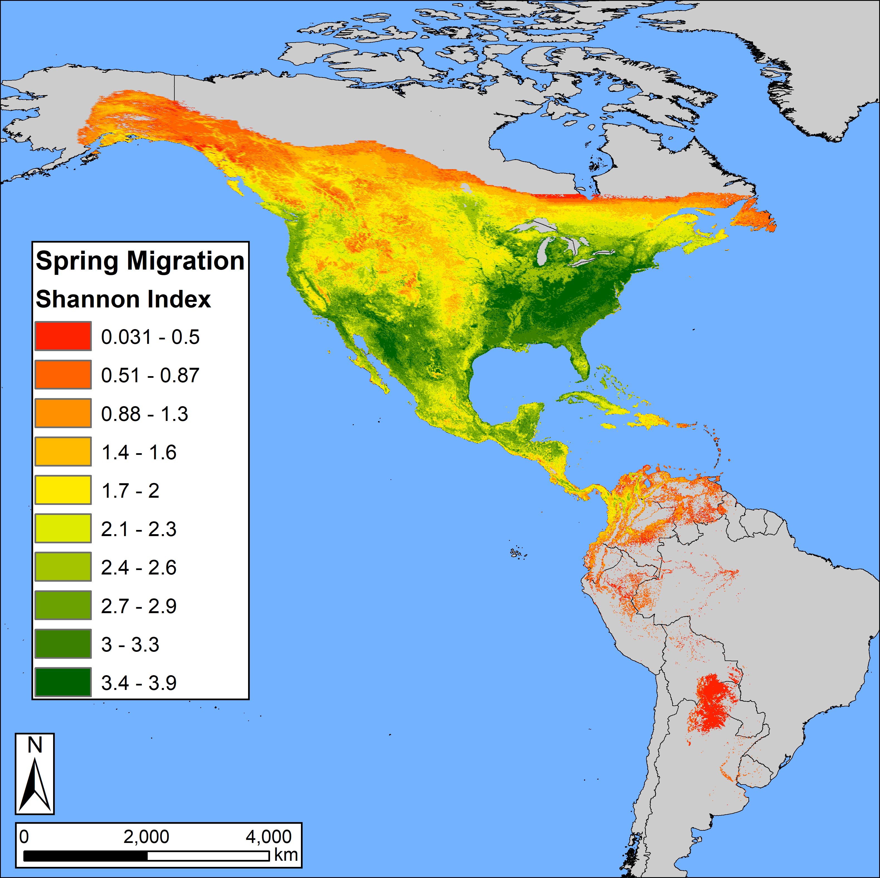
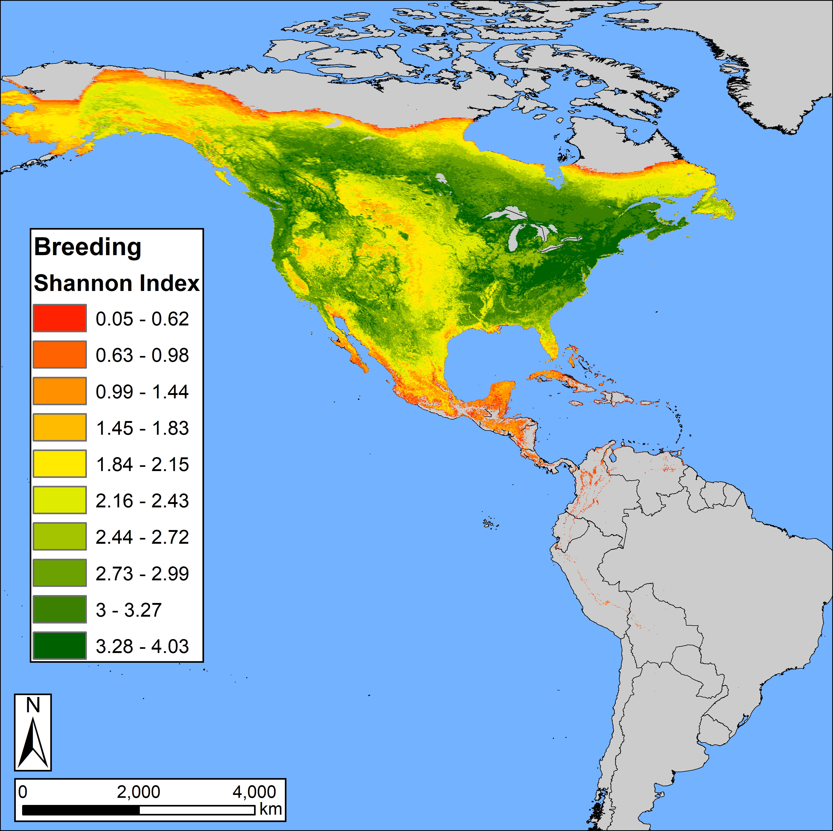
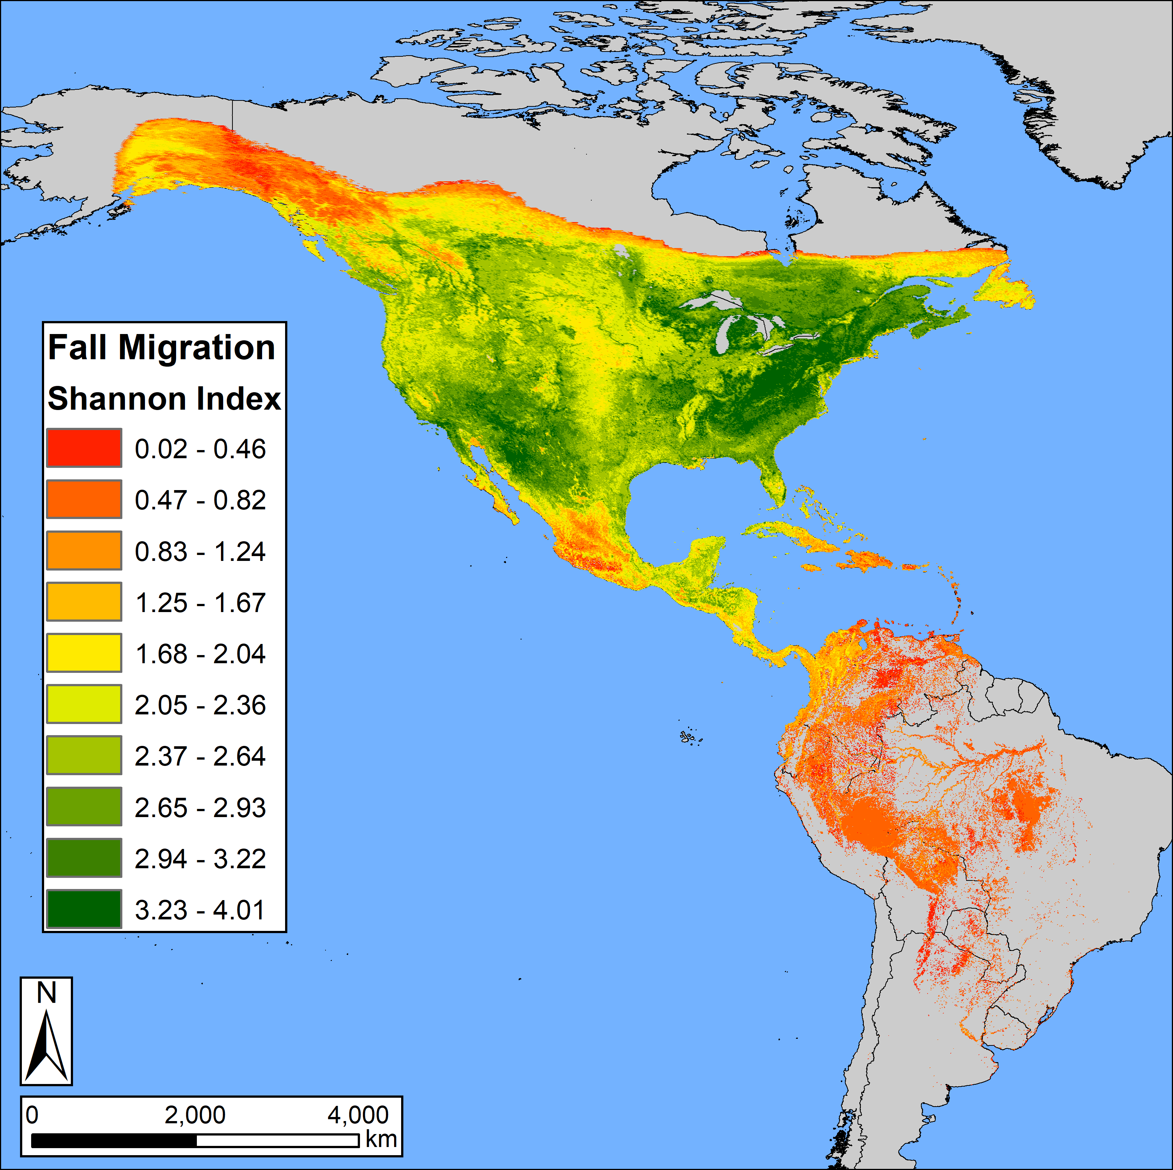
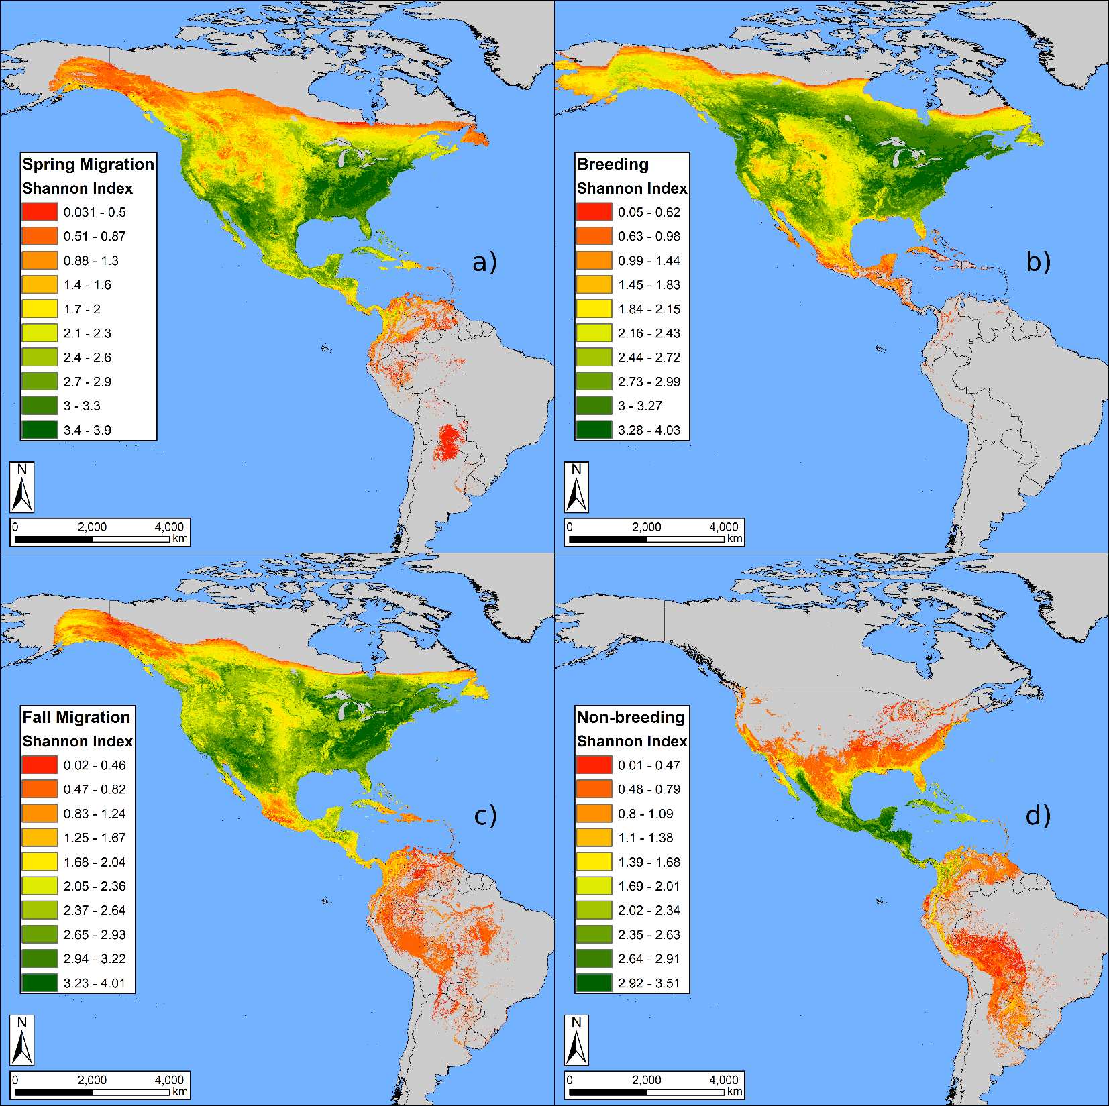

Slide 22
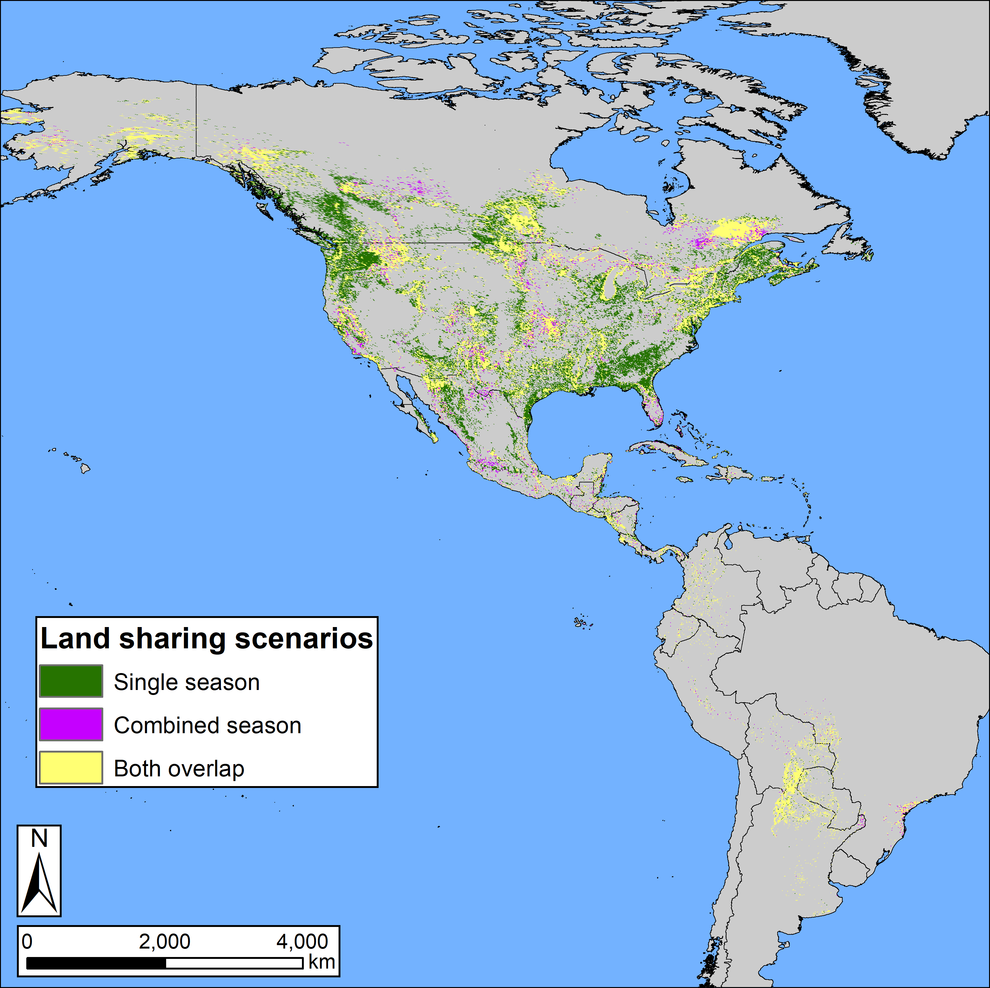
Annual cycle plans were more efficient than single-season plans and reduced the area needed to meet 17% targets by up to 43%.

Slide 23
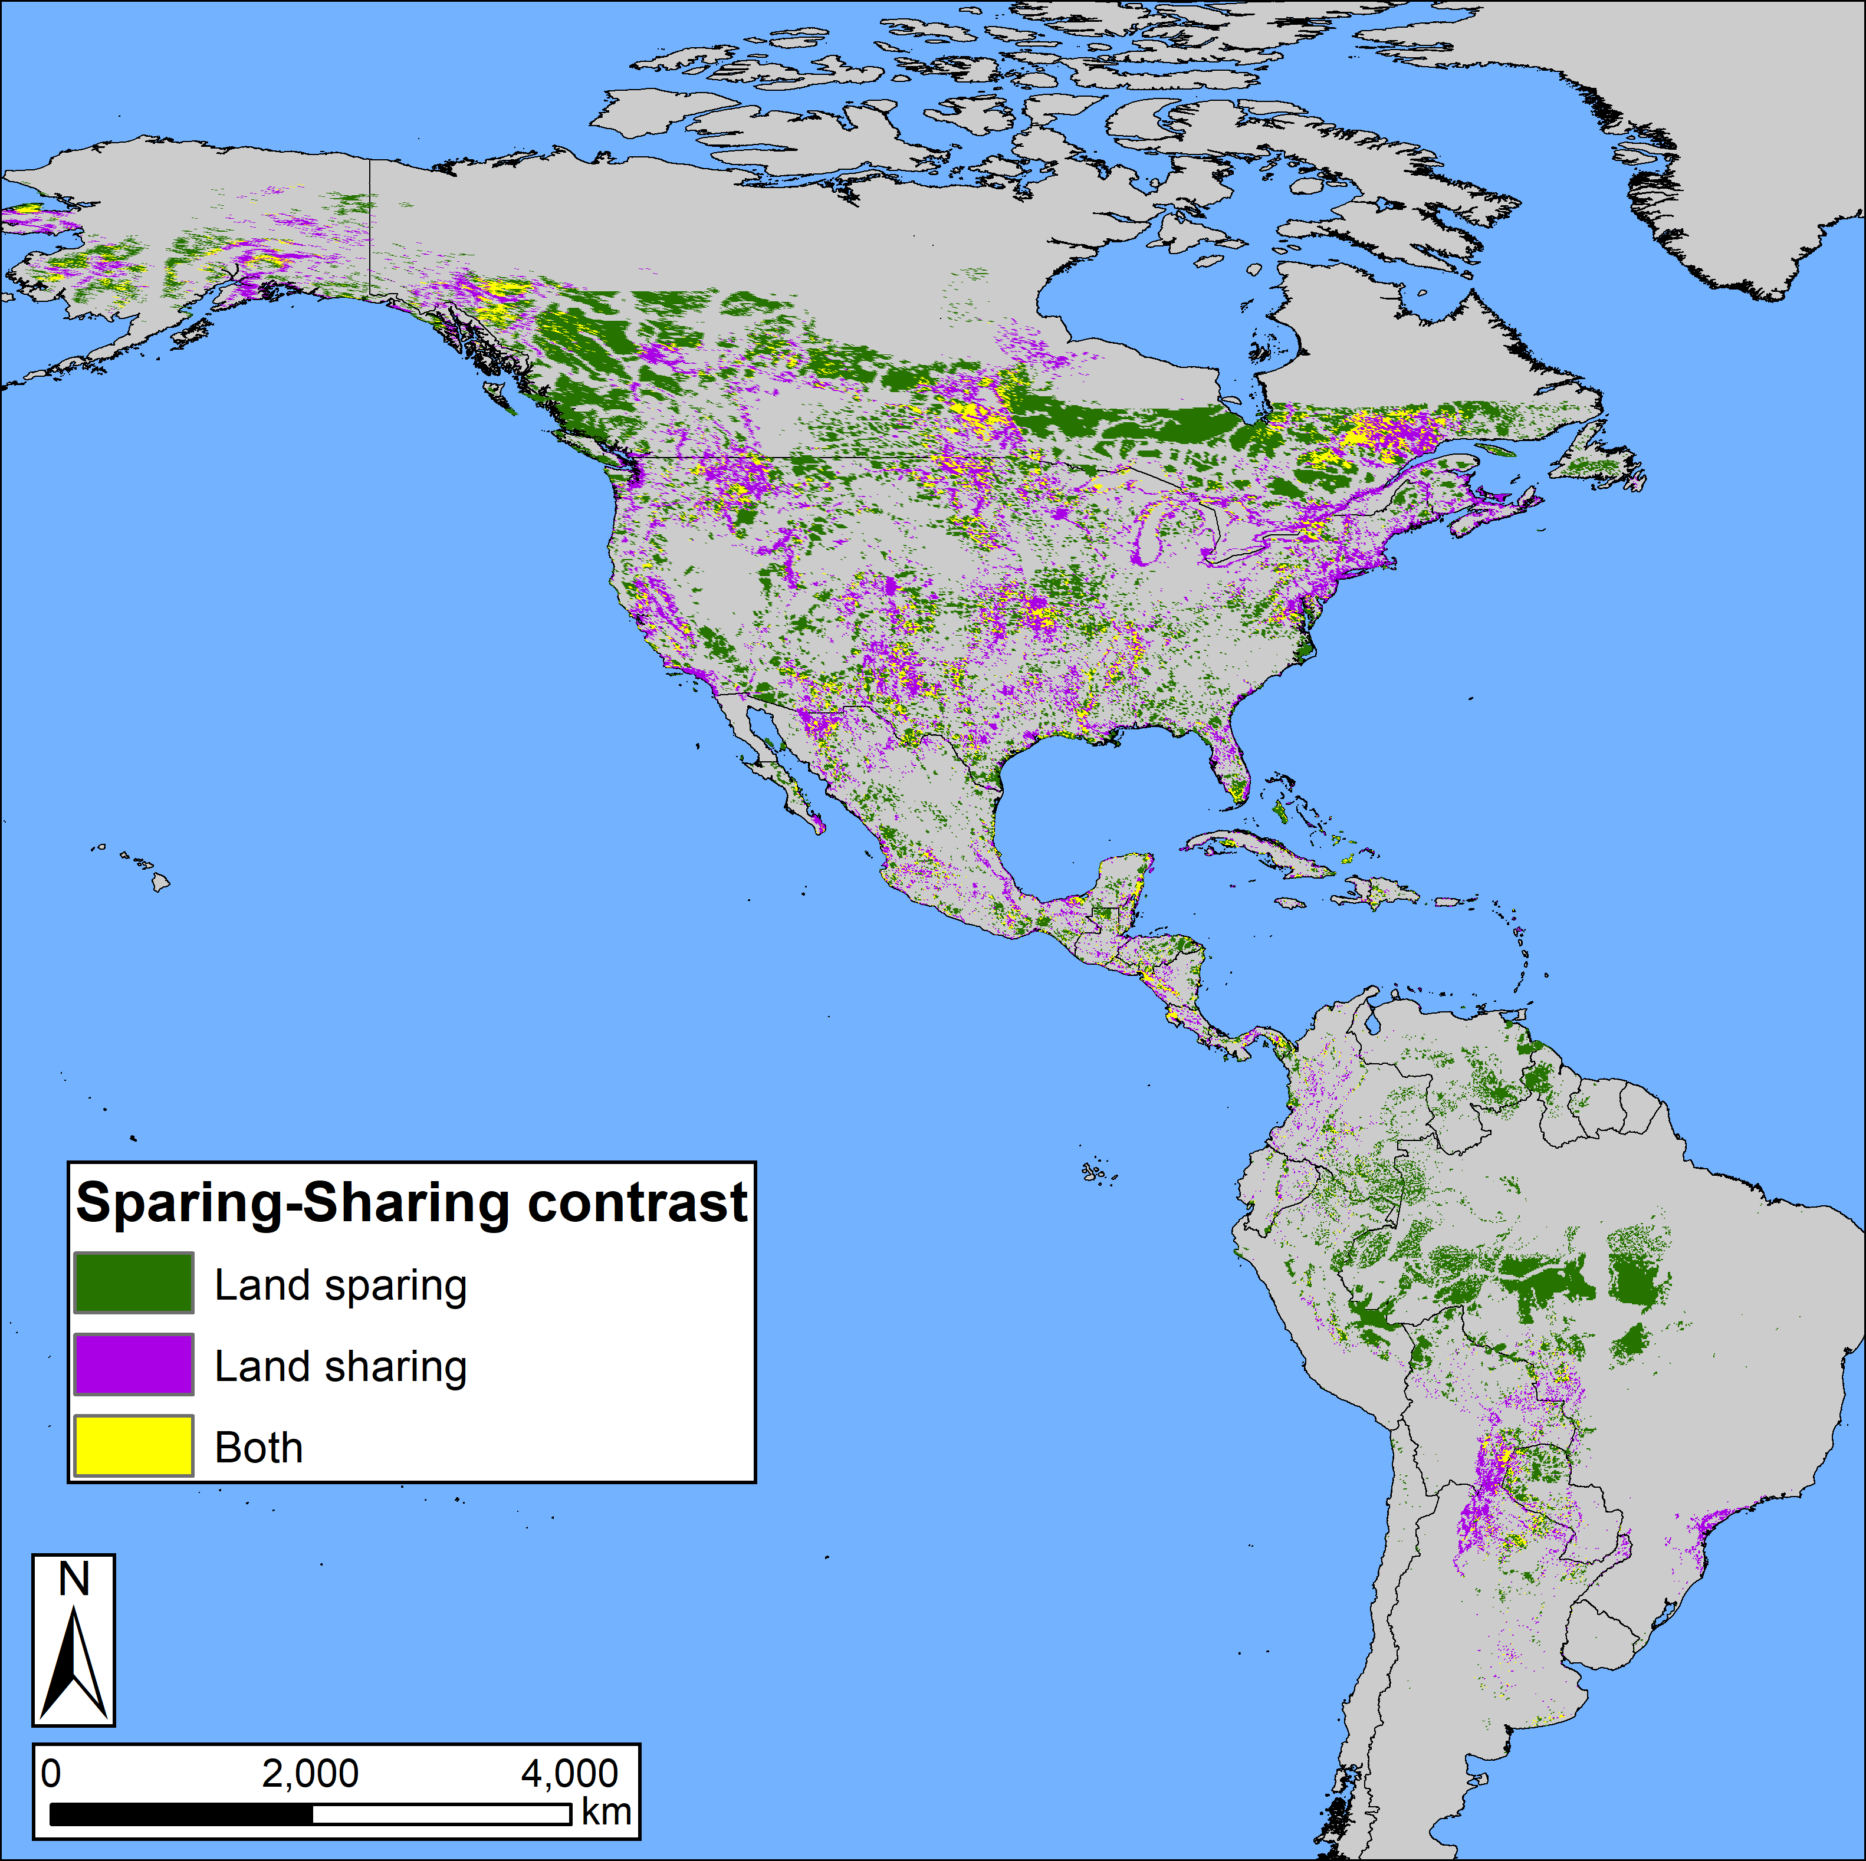
Area efficiency was maximized when land converted by human activity (e.g., agricultural, urban) was included in solutions, suggesting that working landscapes contribute positively to conservation.

Slide 24


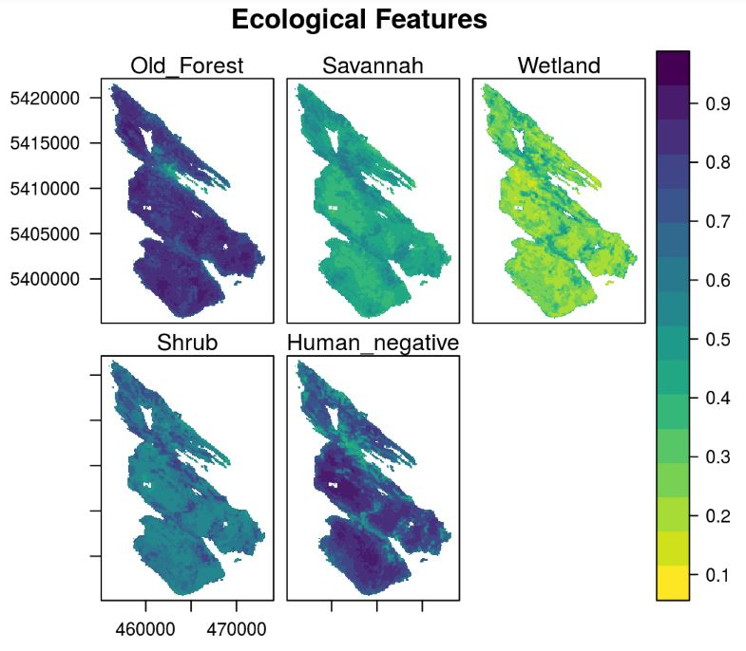
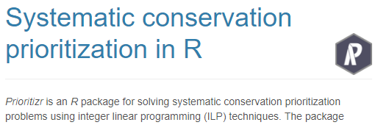
prioritizr
Hanson JO, Schuster R, Morrell N, Strimas-Mackey M, Watts ME, Arcese P, Bennett J, Possingham HP (2017). prioritizr: Systematic Conservation Prioritization in R. R package version 3.0.3.
https://github.com/prioritizr/prioritizr

Slide 25
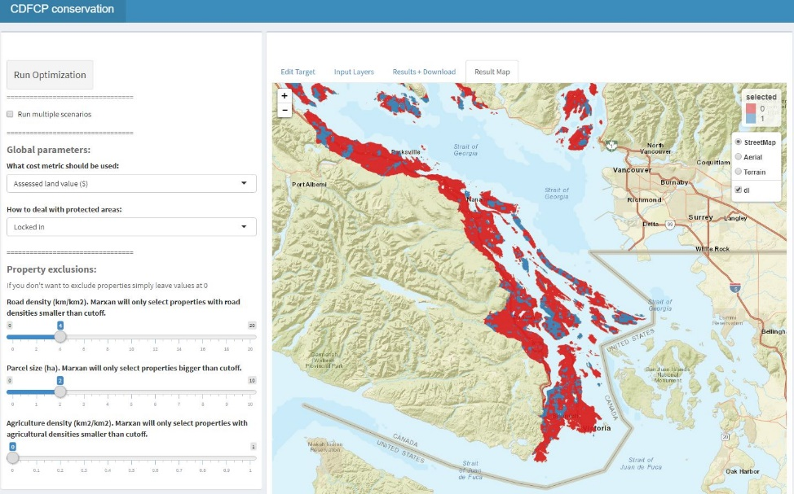
Under development
Combine CDFCP tool with prioritizr to allow users to interactively build and customize conservation planning problems.

